Slide 1
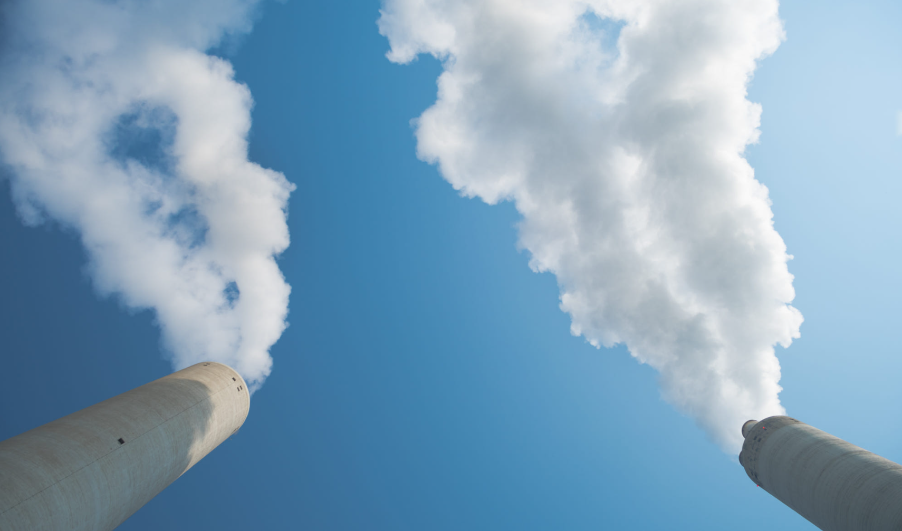
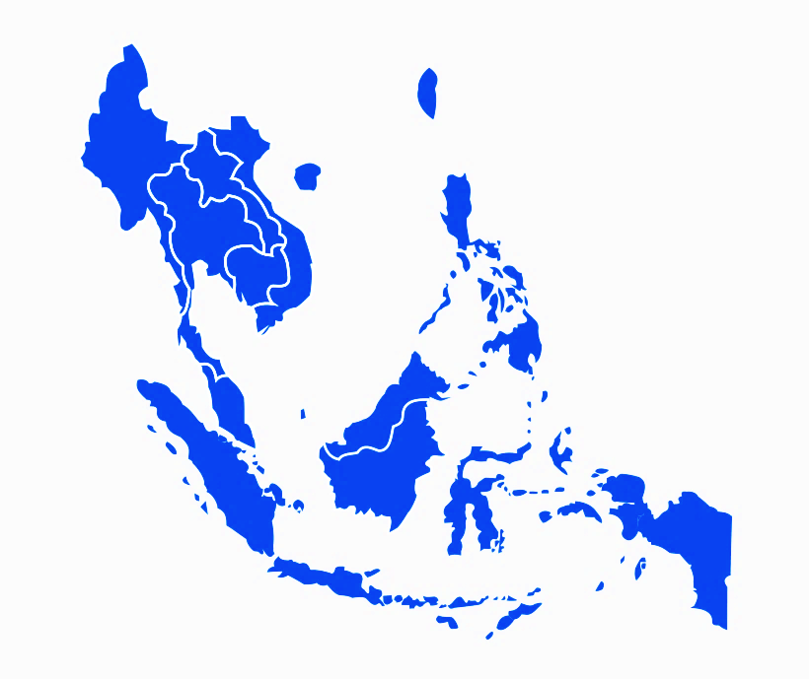
The following countries yearly consume 2,000,000,000 tons of construction materials, accounting for 200,000,000 tons of CO₂ emission.
Singapore
25,000,000 tons/yr
Malaysia
200,000,000 tons /yr
Thailand
400,000,000 tons /yr
Vietnam
500,000,000 tons /yr
Philippine
300,000,000 tons /yr
Indonesia
500,000,000 tons /yr
1 Unit = 25,000,000 tons/yr

Slide 2
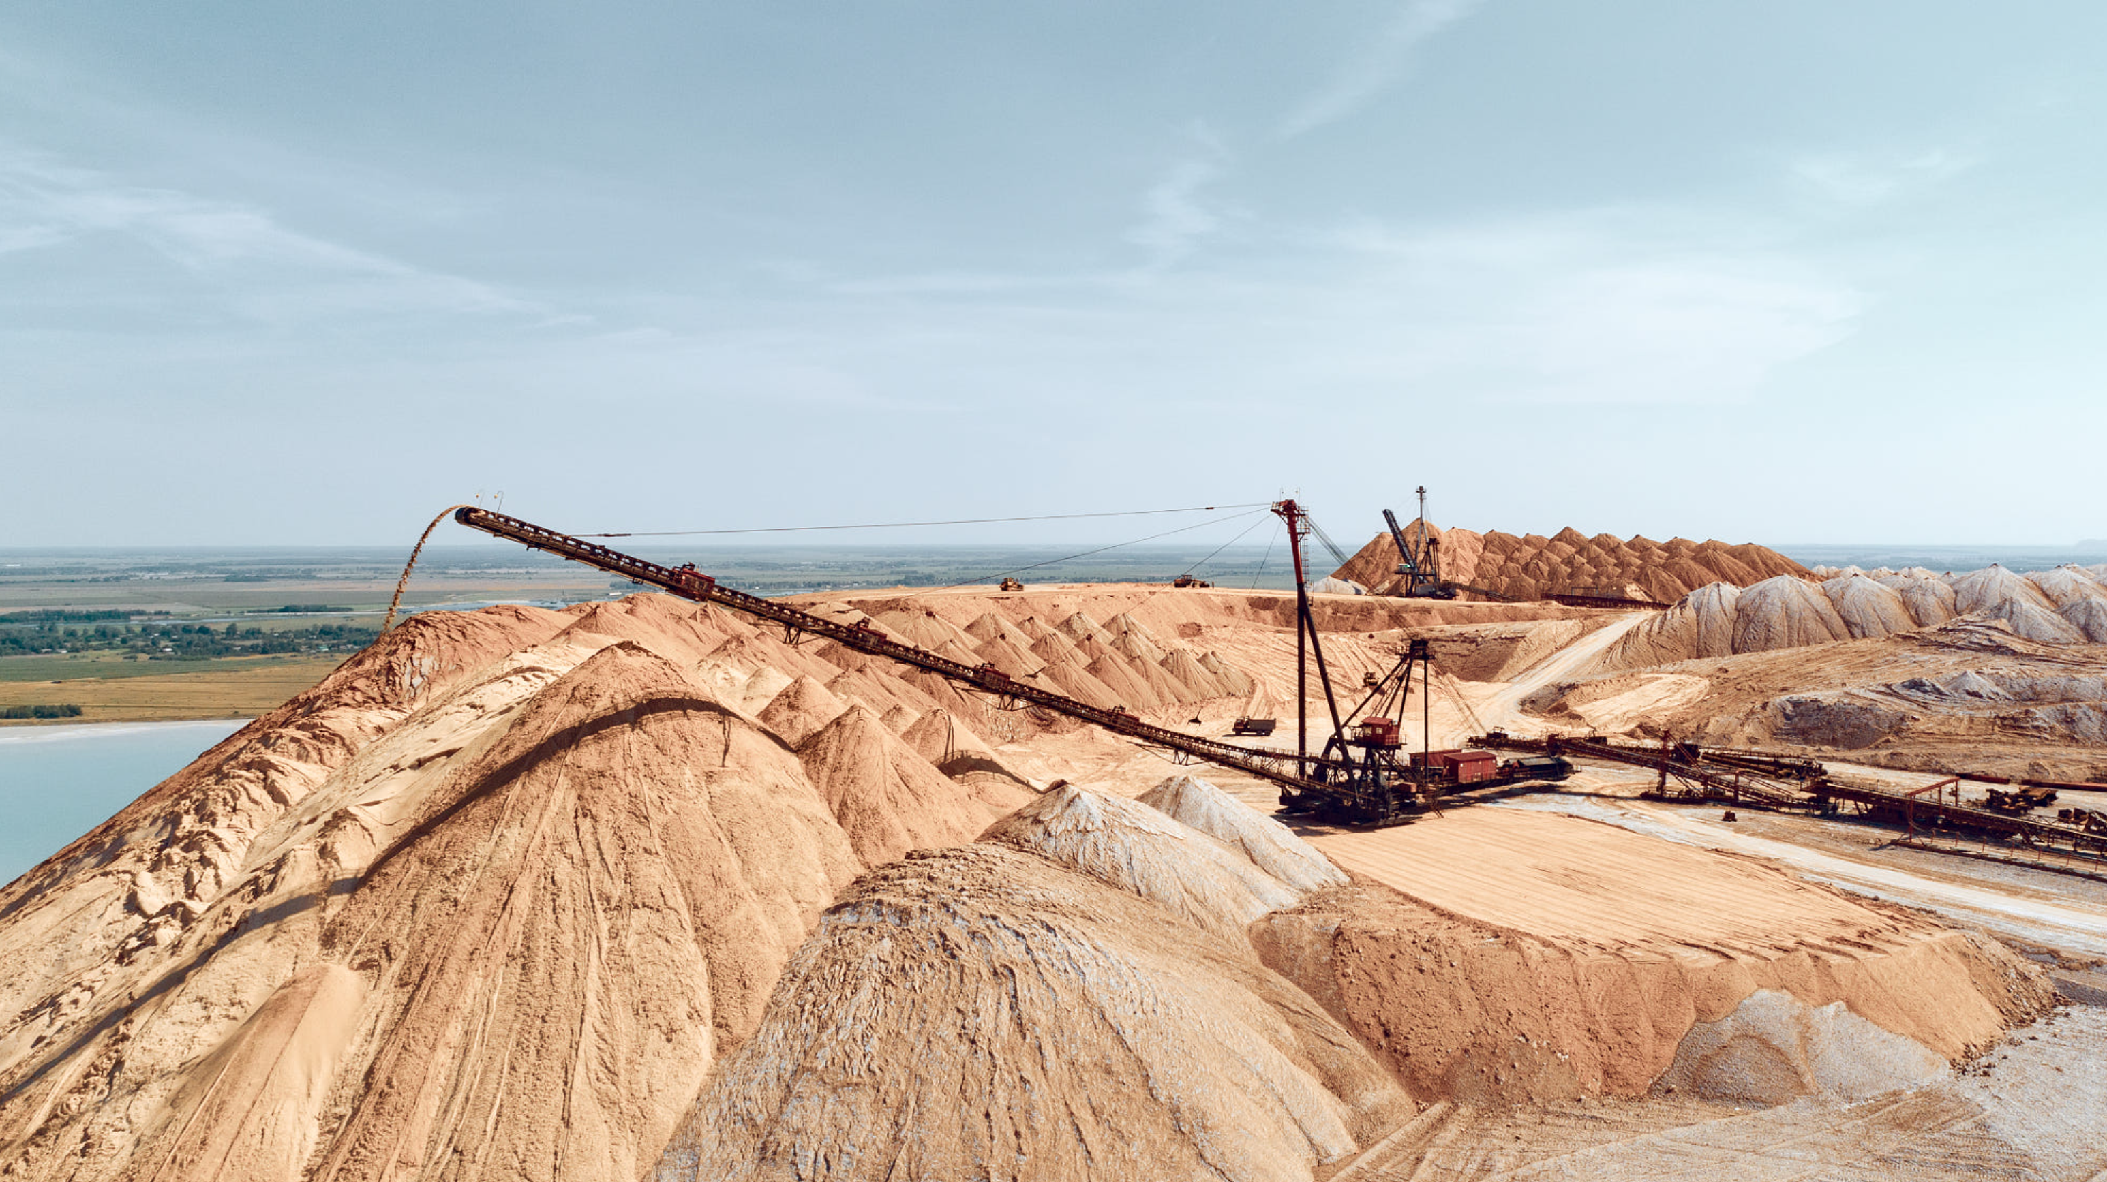
Harvesting sand, gravel and clay for construction materials leaves permanent marks on our landscape and cause long-term damage to our environment that may never recover.
Photo by Andrey Radchenko, from 500px.com

Slide 3
We develop a technology to lock CO₂ in construction waste, and use it to replace a significant amount of normal cement, obtaining great strength.
42.5 MPa (standard strength at 28 days)
Replace 50% cement
Replace 30% cement

Slide 4
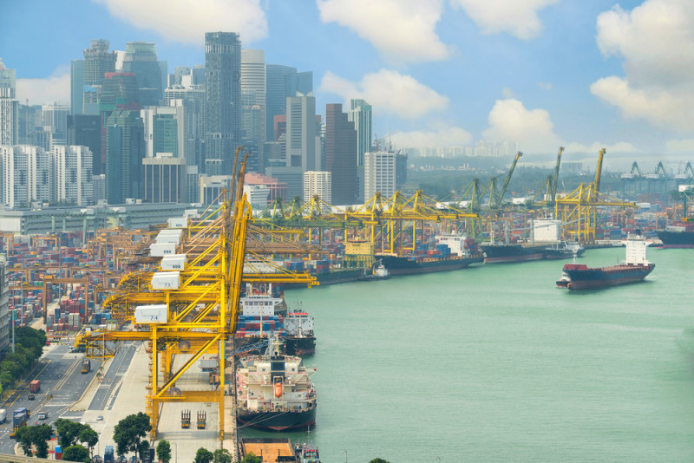
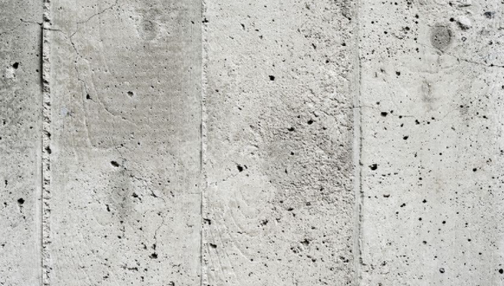
The waste-containing sustainable concrete provides 10 times better resistance to seawater corrosion.
Cl⁻ ingression profile
normal concrete
Sustainable concrete
Corrosion threshold
 | Chloride diffusion coefficient (m²·s⁻¹)
OPC | 1.17×10⁻⁹
LC³ | 2.23×10⁻¹¹
Sea water
Cl⁻
Rebar and concrete

Slide 5
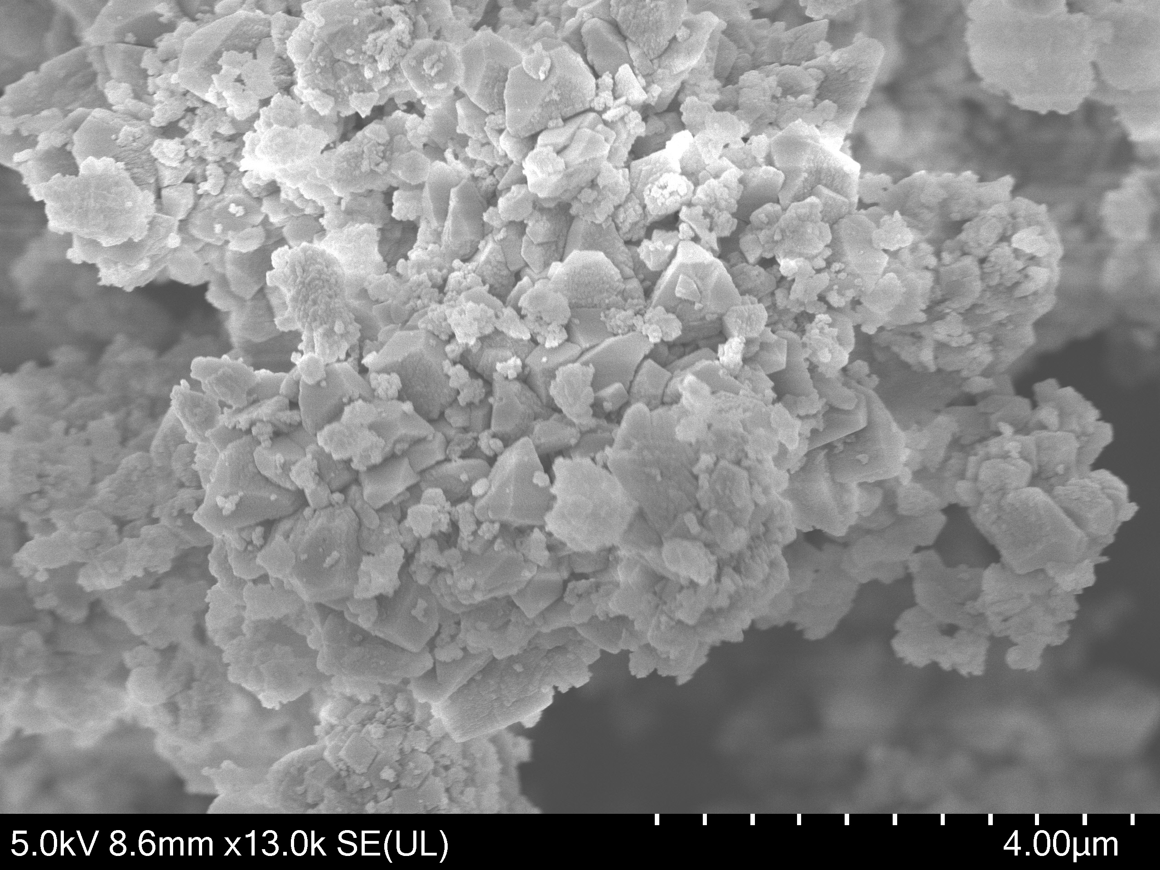
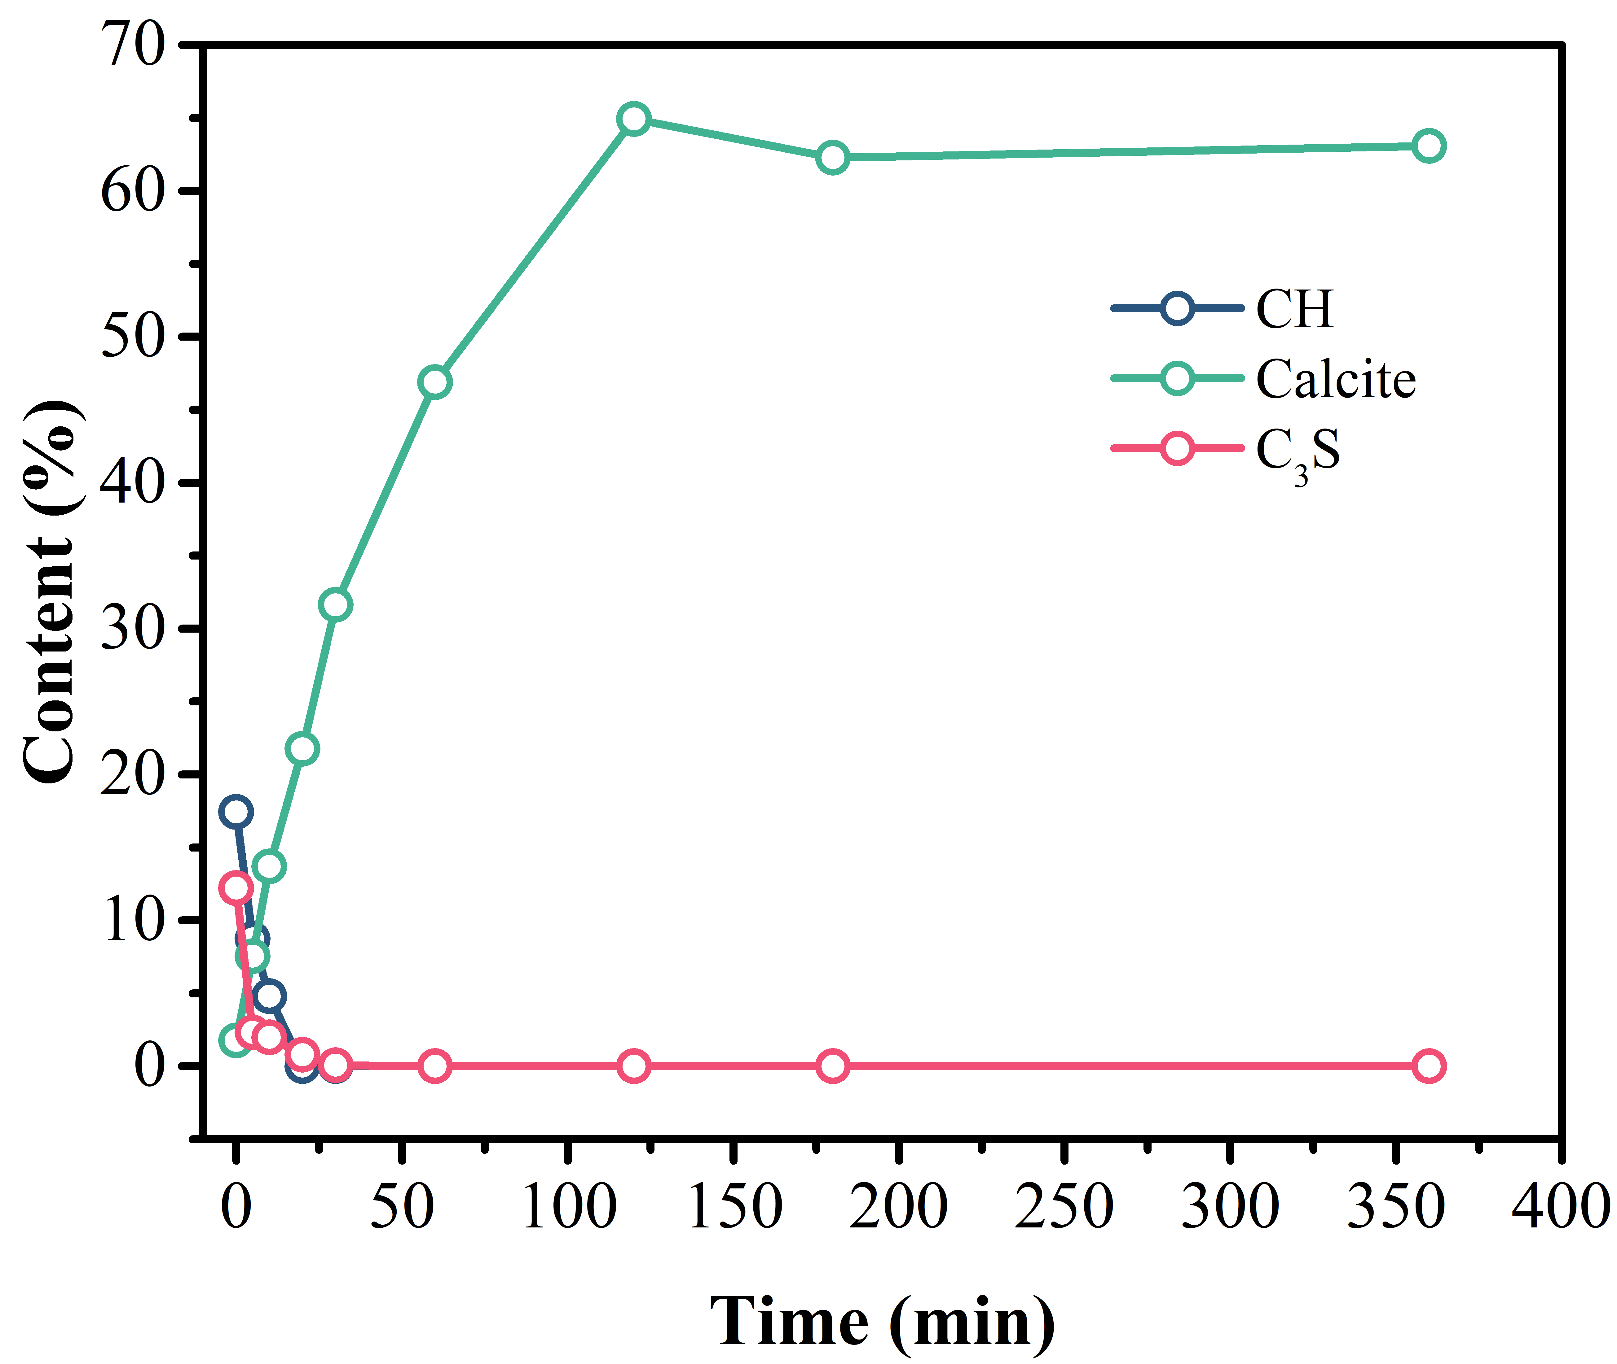
We monitor the kinetics of carbonation process for more effective production.
Silica gel
Calcite

Slide 6
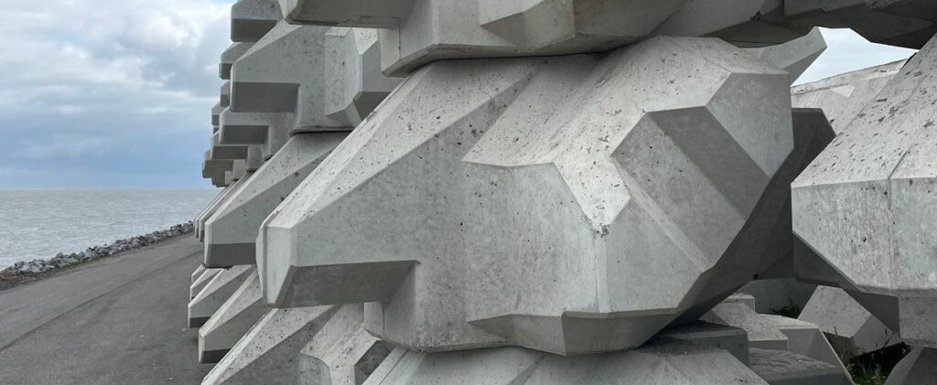
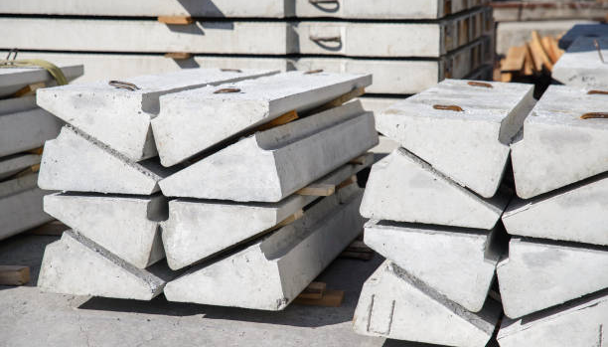
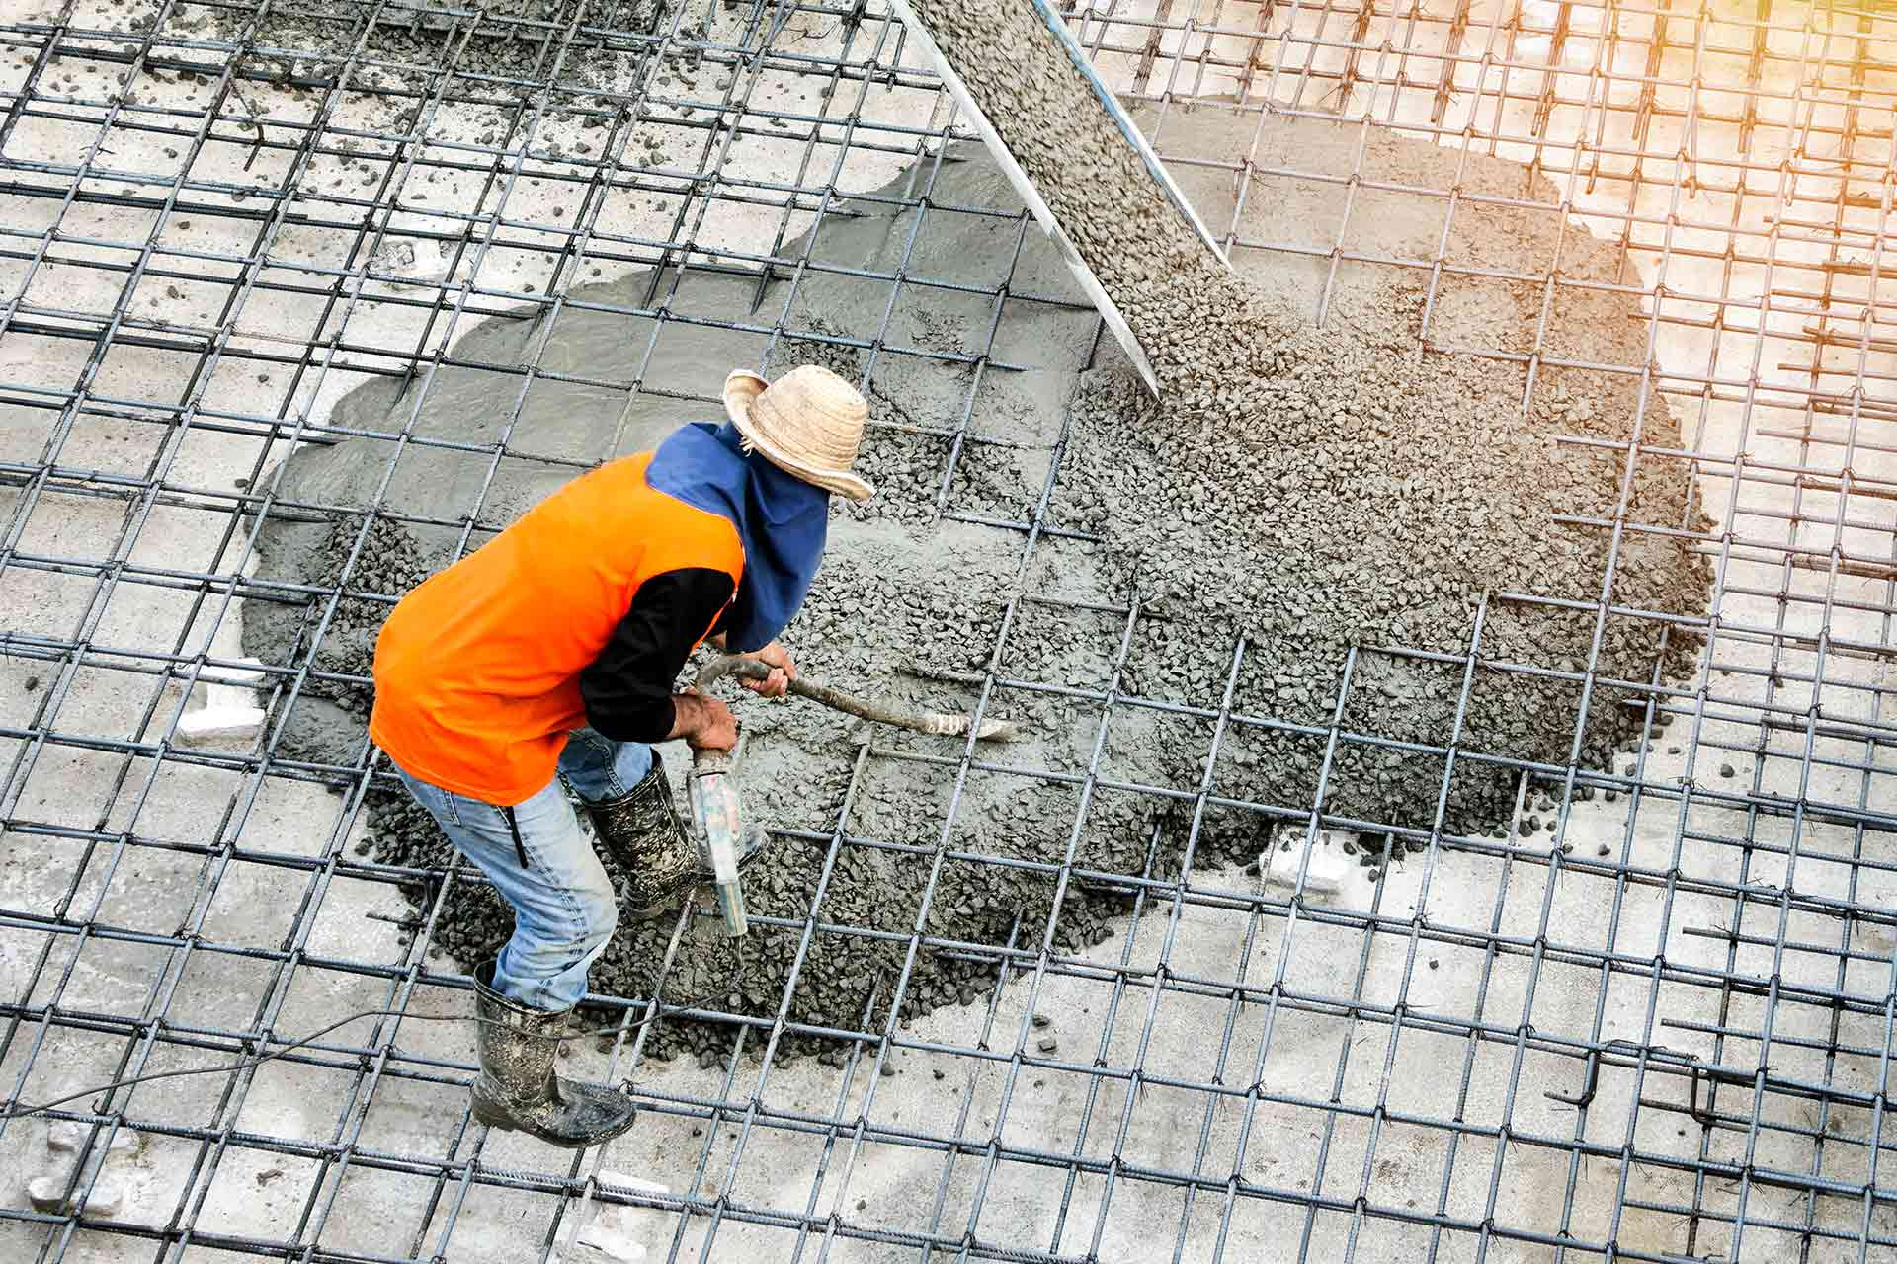
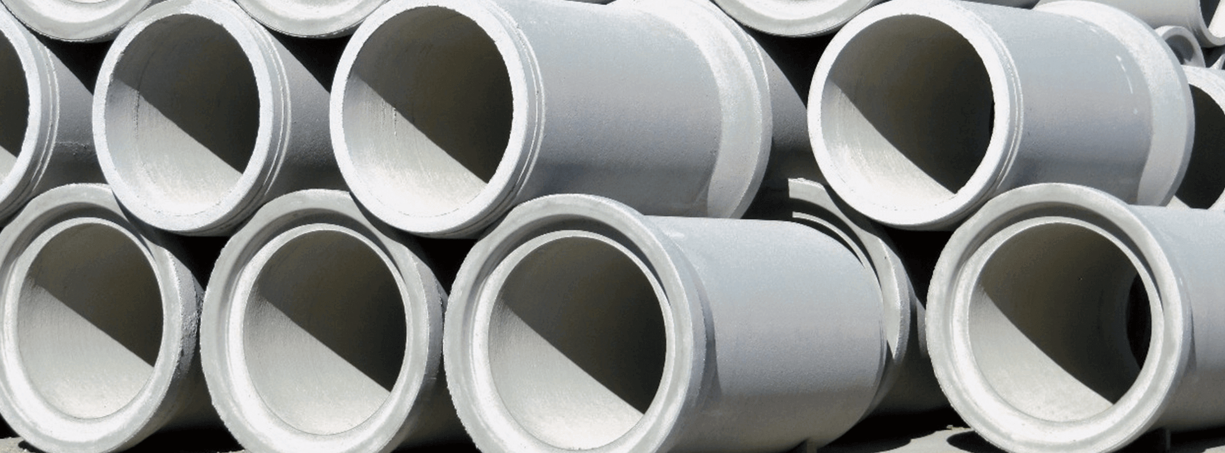
We circulate waste for all types of construction practices in Singapore.

